Slide 1

ARCHITECTURE & ENGINEERING
Infrastructure as Code & Deployment Model
Tiered Deployments
Virtual Testbed
Multi-Technology, Multi-Vendor, Multi-Environment
Tier 0 Generative AI
Notes:
Slide: Architecture & Engineering:
Introduction:
Good [morning/afternoon], everyone.
I am Joshua Magady, the Technology Operations Director and Lead Architect for the Advanced Threat Protection Center.
Today, I am excited to talk about how we design and implement cutting-edge solutions to ensure the security and efficiency of our operations.
Slide Breakdown:
Infrastructure as Code & Deployment Model:
We will explore how we use Infrastructure as Code (IaC) to automate and streamline infrastructure management, ensuring consistency, scalability, and safety.
Tiered Deployments:
We'll discuss our approach to tiered deployments and explain how we use different environments to ensure stability and reliability from development to production.
Virtual Testbed:
I will explain how our virtual testbed allows for comprehensive testing of configurations and deployments in a controlled environment before they go live.
Multi-Technology, Multi-Vendor, Multi-Environment:
We will cover our strategies for integrating various technologies and vendors to create a cohesive, flexible, and robust environment that meets diverse client needs.
Tier 0 Generative AI:
Finally, we will dive into how we are leveraging our Tier 0 Generative AI to enhance our security operations and provide advanced threat detection and response capabilities.
Conclusion:
These topics represent the core of our architecture and engineering efforts, aimed at delivering exceptional value to our clients through innovative and reliable solutions.
Transition to the first topic:
Let's start with the foundation of our approach – Infrastructure as Code (IaC) and our Deployment Model.

Slide 2
INFRASTRUCTURE AS CODE (IAC)
PLAN
Define goals and scope.
DESIGN
Create infrastructure blueprint and strategy.
DEPLOY
Implement infrastructure in target environment.
TEST
Validate infrastructure meets requirements systematically.
01
02
06
05
DEV
OPS
08
07
03
04
RETIRE
Decommission and clean up resources.
MONITOR
Observe and optimize infrastructure performance.
CONFIGURE
Write and version IaC scripts.
BUILD
Construct infrastructure from code automatically.
Notes:
Slide: Infrastructure as Code (IaC)
Introduction:
Infrastructure as Code (IaC) is a key practice that allows us to manage and provision our infrastructure through code rather than through manual processes.
This approach not only automates infrastructure but also makes it programmable and repeatable.
Transition:
Let's dive into the key areas that define our approach to Infrastructure as Code.
Slide Breakdown:
Plan:
We start by defining goals and scope.
This ensures we align our infrastructure needs with our business and our clients, providing clarity and direction from the outset.
Transition:
After planning, we move on to the design phase.
Design:
We create an infrastructure blueprint and strategy.
This blueprint serves as a foundation, ensuring that all components are designed to work together seamlessly, reducing future integration issues and promoting stability.
Transition:
With our design in place, we focus on configuration management.
Configure:
We write and version IaC scripts.
Configuration management allows for consistent environments across development, testing, and production, reducing discrepancies and supporting smoother transitions.
Transition:
Next, we focus on the build process.
Build:
We construct the infrastructure from code automatically.
Automated builds enhance efficiency and scalability, enabling us to respond quickly to changing demands.
Transition:
Once built, it’s crucial to thoroughly test the infrastructure.
Test:
We systematically validate the infrastructure.
Rigorous testing ensures that our infrastructure meets all requirements and performs reliably under all conditions, minimizing downtime and service interruptions.
Transition:
After testing, we proceed to deployment.
Deploy:
We implement the infrastructure in the target environment.
Rapid deployment with minimal manual intervention means faster time-to-market and reduced human error.
Transition:
After deploying, monitoring is essential to maintain performance.
Monitor:
We observe and optimize our infrastructure.
Continuous monitoring and optimization ensure our infrastructure is always performing at its best, providing high availability and performance for our services.
Transition:
Finally, we must consider the retirement of resources.
Retire:
We decommission and clean up.
Properly retiring resources helps in cost management and security, ensuring no unused resources are left running that could incur costs or pose security risks.
Additional Benefits:
Consistency:
By treating infrastructure as code, we achieve consistent environments, eliminating "it works on my machine" problems.
Scalability:
IaC makes it easy to scale up or down based on our clients' needs without manually configuring each server or service.
Reusability:
Code can be reused across projects, saving time and reducing the likelihood of errors.
Auditability:
Every change is tracked and version-controlled, providing a clear audit trail for compliance and troubleshooting.
Conclusion:
Infrastructure as Code transforms the way we deliver value to our customers.
It brings speed, reliability, and consistency to infrastructure management, ensuring that we can meet our clients' business needs effectively and efficiently.
Transition to the Next Topic:
Next, we will discuss how our tiered deployment model builds on this foundation to further enhance the robustness and flexibility of our solutions.

Slide 3
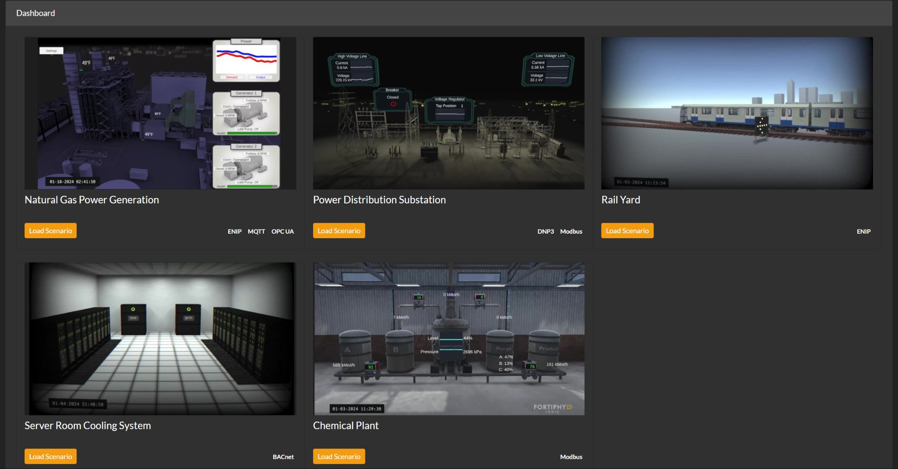
VIRTUAL TESTBED
Notes:
Slide: Virtual Testbed
Introduction:
Our Virtual Testbed is a powerful tool that allows us to simulate different client environments and rigorously test our solutions before they are deployed in the real world.
Overview of the Virtual Testbed:
The Virtual Testbed is a versatile and comprehensive testing platform where we can create detailed simulations of various client environments.
This includes everything from power distribution substations to chemical plants and server room cooling systems.
Transition:
Let's explore the different simulated environments we use within our Virtual Testbed.
Slide Breakdown:
Simulated Environments:
Description: Our Virtual Testbed includes a range of simulated environments, such as Natural Gas Power Generation, Power Distribution Substations, Rail Yards, Server Room Cooling Systems, and Chemical Plants.
Customer Value: This diversity allows us to model and test our solutions in environments that closely mirror our clients' operational settings.
By doing so, we can identify and mitigate potential issues before they arise in the real world.
Integration Testing:
Description: The Virtual Testbed enables comprehensive integration testing of new technologies and systems within a simulated but realistic environment.
Customer Value: By conducting thorough integration testing, we can ensure that all components work seamlessly together, reducing the risk of integration issues when the solution is deployed in the client's environment.
Cost Efficiency:
Description: The Virtual Testbed allows us to conduct extensive testing without the need for physical infrastructure, significantly reducing costs.
Customer Value: These cost savings can be passed on to our clients, making our solutions more affordable while maintaining high standards of quality and reliability.
Continuous Improvement:
Description: The Virtual Testbed provides a platform for continuous improvement and innovation.
We can regularly update and enhance our simulations to keep pace with technological advancements and emerging threats.
Customer Value: This commitment to continuous improvement ensures that our clients benefit from the latest innovations and are always protected against new and evolving threats.
Modeling Attack Scenarios:
Description: The Virtual Testbed allows us to model various attack scenarios, simulating potential threats to identify vulnerabilities.
Customer Value: By understanding how different attack vectors could impact our clients' environments, we can develop robust defense recommendations and help our clients preemptively address weaknesses.
Building Detections:
Description: We can build and test detection mechanisms within the Virtual Testbed.
Customer Value: This ensures that our security measures are effective and can detect threats accurately, enhancing the overall security posture of our clients.
Applying Detections to Client Security Lake:
Description: Once detections are validated, we apply them to our client security data lake, integrating them with existing security infrastructure.
Customer Value: This seamless integration enhances real-time threat monitoring and response capabilities, providing clients with proactive and comprehensive security solutions.
Conclusion:
The Virtual Testbed is a cornerstone of our testing and deployment strategy.
It allows us to rigorously test our solutions in a controlled environment that mirrors real-world conditions, ensuring they are robust, reliable, safe, and ready for deployment.
This not only enhances the quality of our solutions but also provides our clients with the confidence that their systems will perform as expected.
Transition to the Next Topic:
Next, we will discuss how we integrate multiple technologies, vendors, and environments to create a seamless and flexible infrastructure for our clients.

Slide 4
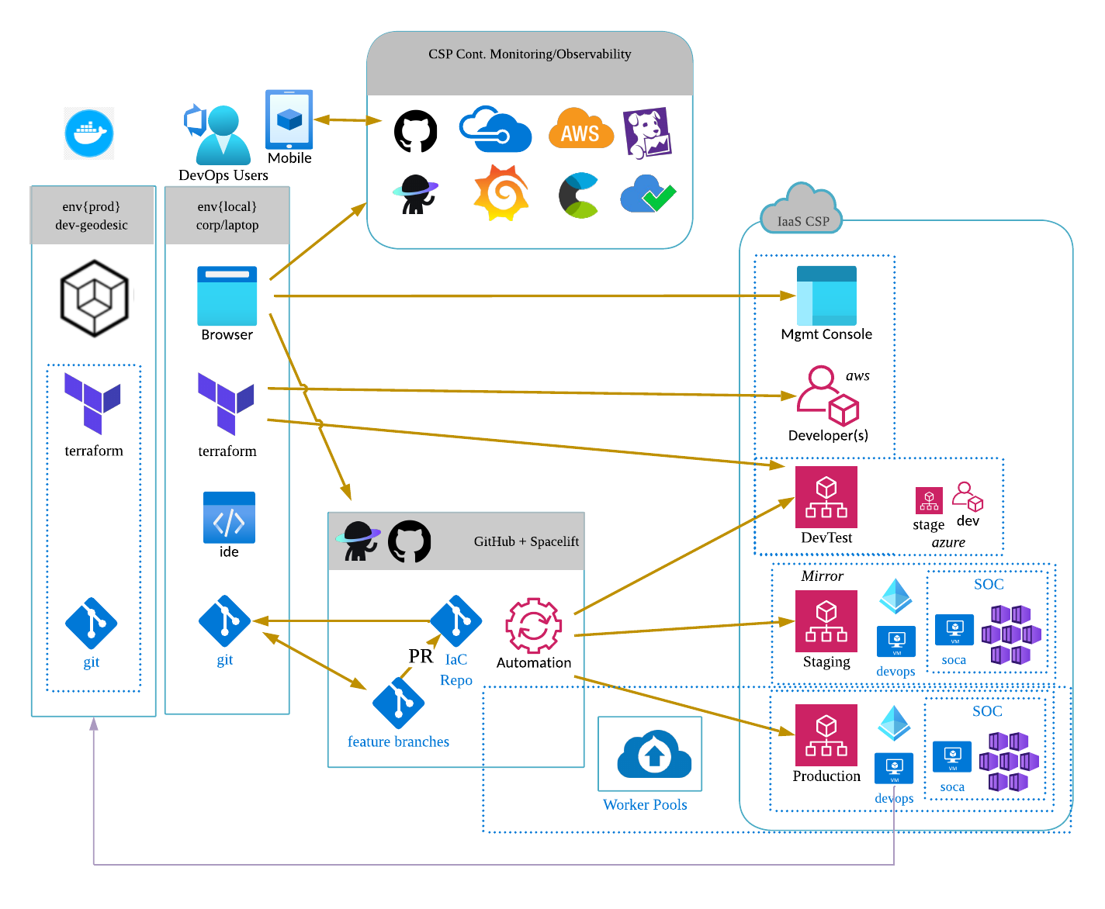
Three Tier Deployments
Dev
Stage
Prod
Experiment
Verification
Stability
- Frequent changes
- Extensive testing
- Integration testing
- User acceptance testing
- Stable
- Limited changes
Green marketing is a practice whereby companies seek to go
Green marketing is a practice whereby companies seek to go
Green marketing is a practice whereby companies seek to go
Notes:
Slide: Three Tier Deployments
Introduction:
Let’s dive into our tiered deployment model.
This model is fundamental to how we ensure the reliability, stability, and efficiency of our deployments.
Overview of the Three Tiers:
Our deployment process is structured into three distinct environments: Development (Dev), Staging (Stage), and Production (Prod).
Each tier serves a unique purpose and plays a crucial role in our overall deployment strategy.
Slide Breakdown:
Development (Dev):
Experimentation:
Description: The development environment is where frequent changes and extensive testing occur.
This is the playground for our engineers to experiment, develop new features, and fix bugs.
Customer Value: By allowing for frequent updates and thorough testing, we ensure that any potential issues are identified and resolved early.
This minimizes the risk of defects making their way into later stages, ultimately resulting in a more reliable product for our clients.
Staging (Stage):
Verification:
Description: The staging environment is an exact replica of the production environment.
Here, we conduct integration testing and user acceptance testing to verify that everything works as intended.
Customer Value: This verification step is critical for ensuring that new features and changes integrate seamlessly with existing systems.
By mirroring the production environment, we can catch and address any issues that might not have been apparent in the development environment, providing an additional layer of assurance and safety.
Production (Prod):
Stability:
Description: The production environment is where the final, stable version of our applications and systems run.
This environment undergoes limited changes to maintain stability, safety, and ensure uninterrupted service.
Customer Value: Stability and Safety is paramount in production.
By minimizing changes and thoroughly testing everything in prior stages, we ensure that our services run smoothly and reliably.
This approach minimizes downtime and provides a consistent user experience.
Conclusion:
Our three-tier deployment model is designed to balance innovation with stability, security with speed, and prioritizing safety.
By isolating development, testing, and production environments, we can experiment and innovate rapidly while ensuring that only thoroughly tested and verified changes make it to production.
This structured approach reduces the risk of disruptions and ensures a high level of service reliability.
Transition to the Next Topic:
Next, we will explore how we use a virtual testbed to further enhance our testing and deployment processes, ensuring that our solutions are robust and ready for any environment.

Slide 5


MULTI-TECHNOLOGY, MULTI-VENDOR, MULTI-ENVIRONMENT
CUSTOMER INTERACTION
CLIENT
PORTAL
MSSP COMPONENTS
AI SUBCOMPONENTS
BROADCAST EVENTS
THREAT MANAGEMENT AND SHARING SYSTEM
EVENT CATEGORIZATION
SECURITY
OPERATIONS
CENTER
ENRICHED METADATA
BROADCAST EVENTS
SECURITY LAKE
EVENT SUMMARIZATION
ENRICHED METADATA
SOC
ANALYST
SINGLE
PANE OF
GLASS
SOAR
PLATFORM
BROADCAST EVENTS
AI-POWERED EVENT
ANALYSIS AND SUMMARIZATION
CASE CONSOLIDATION
ENRICHED METADATA
CENTRAL
EVENT
BUS
BROADCAST EVENTS
AUTOMATED RECOMMENDATIONS
VULNERABILITY
MANAGEMENT
ENRICHED METADATA
ADAPTIVE LEARNING
BROADCAST EVENTS
INCIDENT
RESPONSE
ENRICHED METADATA
BROADCAST EVENTS
COMPLIANCE
MONITORING
ENRICHED METADATA
RESPONSE
ACTIONS
RELAY
EVENTS
EVENT Consumers
CUSTOMER SITE
Green marketing is a practice whereby companies seek to go
Green marketing is a practice whereby companies seek to go
Green marketing is a practice whereby companies seek to go
Notes:
Slide: Multi-Technology, Multi-Vendor, Multi-Environment
Introduction:
To address our clients' complex challenges, we have developed a robust, multi-technology, multi-vendor, and multi-environment architecture.
This approach ensures flexibility, scalability, and comprehensive security coverage.
Overview of the System:
Our solution involves the deployment of Event Consumers at the customer site, responsible for collecting security events and relaying them to our Central Event Bus.
The Central Event Bus is the heart of our Managed Security Service (MSS), ensuring that all collected data is processed and utilized efficiently.
This means we can process events in as close to real-time as the clients chosen vendor platforms allow.
Transition:
Let's start by discussing how we handle the ingestion of security events through our Event Consumers.
Slide Breakdown:
Event Consumers:
Description: Event Consumers are deployed at the customer site to collect security events from various sources.
Customer Value: This setup ensures that all security events, regardless of their origin, are collected and processed efficiently, providing a comprehensive security view.
Central Event Bus:
Description: The Central Event Bus receives events from the Event Consumers and broadcasts them to different components within the system for processing.
Customer Value: This centralization allows us to integrate data from various platforms and systems, making our solution vendor-agnostic and highly adaptable to different technologies and environments.
Key MSSP Components:
Threat Management and Sharing System:
Description: The Threat Management and Sharing System analyzes and correlates threats to provide actionable intelligence.
Customer Value: This enhances threat detection and response capabilities, ensuring timely mitigation of security risks.
Security Data Lake:
Description: Our Security Data Lake manages events and logs for long-term storage and analysis.
Customer Value: This provides a scalable solution for log management and compliance reporting.
SOAR Platform:
Description: Our SOAR Platform orchestrates and automates incident response processes.
Customer Value: This reduces response times and improves the efficiency of our security operations.
AI-Powered Event Analysis and Summarization:
Description: Our AI-powered event analysis system leverages multi-model generative AI (with a human in the loop) to reduce cognitive load by summarizing and prioritizing events.
Customer Value: This enables faster and more accurate decision-making.
AI Subcomponents:
Description: Our AI subcomponents include Event Categorization, Event Summarization, Case Consolidation, Automated Recommendations, and Adaptive Learning.
Customer Value: These advanced AI capabilities improve the accuracy and efficiency of our security operations, providing enhanced protection and insights.
Vendor-Agnostic Data Collection:
Description: Our architecture supports vendor-agnostic data collection, meaning we can seamlessly integrate with any security solution our clients are using.
Customer Value: This flexibility ensures that our clients can continue to use their preferred technologies while benefiting from our comprehensive security services without any compatibility issues.
Conclusion:
Our multi-technology, multi-vendor, and multi-environment architecture is designed to be flexible and scalable.
This enables us to provide comprehensive security solutions tailored to the unique needs of each client.
By leveraging a central event bus and integrating various advanced components, we ensure that our clients benefit from a robust, adaptable, and efficient security infrastructure.
Transition to the Next Topic:
Next, we will discuss how we leverage our Tier 0 Generative AI to further enhance our security operations, providing advanced threat detection and response capabilities.

Slide 6
DATA FEED
ALERT
DETAILS
CLIENT LOOKUP
NETWORK DETAILS
RULES OF ENGAGEMENT
ACCESS ATTEMPT DETECTED
CLIENT
CONTEXT
CONTACT LIST
CONTEXT
METADATA
RESPONSE CAPABILITIES
LOGIN FAILED FOR USER: ADMIN
ETC.
ALERT:
UNAUTHORIZED
ACCESS
ATTEMPT
DETECTED
PULL CLIENT DETAILS
INCORRECT PASSWORD ENTERED
EVENT
STREAM
PROCESS
CLIENT CONTEXT: ACME ABC
ACCESS DENIED: FINANCIAL DATA
SUMMARIZE:
AN UNAUTHORIZED USER ATTEMPTED TO ACCESS THE FINANCIAL_DATA …
CREATE PLAYBOOK
PLAYBOOK: UNAUTHORIZED ACCESS ALERT ON FIN … STEP 1: VERIFY THE ALERT …
STEP 2: IDENTIFY THE SCOPE …
ETC.
UNAUTHORIZED ACCESS DETECTED
STEP 1
STEP 2
STEP 3
STEP 4
CONFIRMED:
MALICIOUS
QUERY: SELECT*
FROM LOGS
WHERE CLIENT = ACME ABC
AND MESSAGE = ‘UNAUTHORIZED ACCESS DETECTED’ AND …
CREATE
RESPONSE
ACTION
SUMMARY OF
ACTIONS
TIER 0 GENERATIVE AI
ADD TO
BLOCK LIST: 192.168.1.00
REST STATES
FOR 192.168.1.100
TRIGGER PASSWORD RESET: ADMIN
NOTIFY
CLIENT
GENERATIVE AI PIPELINE
Green marketing is a practice whereby companies seek to go
Green marketing is a practice whereby companies seek to go
Green marketing is a practice whereby companies seek to go
Notes:
Slide: Tier 0 Generative AI
Introduction:
Lastly, let's look at our Tier 0 Generative AI process.
While this is still in early research and development, it represents a significant leap forward in our ability to automate and enhance security incident response.
Overview of the Process:
Our Generative AI security incident response pipeline leverages advanced AI techniques to handle incidents more efficiently, effectively, and safely.
Here's how it functions:
Slide Breakdown:
Data Feed and Event Stream:
Description: Security events, such as access attempts, failed logins, and unauthorized access detections, are continuously monitored and fed into our event stream.
Customer Value: This real-time monitoring ensures that potential security incidents are identified as soon as they occur, enabling a more rapid response.
Transition:
Once an event triggers an alert, we move to the alert details phase.
Alert Details:
Description: When an event triggers an alert, such as an unauthorized access attempt, it is forwarded to our Event Analysis and Summarization system.
Customer Value: Immediate alerting and detailed analysis help in quickly understanding the nature and severity of the incident.
Transition:
After alerting, the system performs a client lookup and context generation.
Client Lookup and Context Generation:
Description: The system pulls relevant client details and context, including network details, rules of engagement, contact lists, and response capabilities.
Customer Value: By incorporating client-specific information, we ensure that the response is tailored to the unique needs and capabilities of each client, increasing the effectiveness of the response.
Transition:
With the context generated, we proceed to summarization and playbook creation.
Summarization and Playbook Creation:
Description: The context is used to summarize the alert and generate a playbook tailored to the specific event and client.
Customer Value: Automated playbook creation streamlines the response process, ensuring that all necessary steps are outlined and ready for execution without delay.
Transition:
Next, we move on to executing response actions.
Response Actions:
Description: Commands are generated from the playbook to confirm the alert, identify the scope, and execute response actions. This can include blocking offending IPs, resetting states, and triggering password resets.
Customer Value: Automated response actions reduce the time to mitigate threats, limiting potential damage and improving overall security posture.
Transition:
Finally, we generate an incident summary report.
Incident Summary Report:
Description: A detailed report summarizing the incident and the actions taken is generated for the analyst to review.
Customer Value: Providing a comprehensive summary allows security analysts to quickly understand what happened, why it happened, and what actions were taken, facilitating faster decision-making and post-incident analysis.
Conclusion:
Our Tier 0 Generative AI process is designed to enhance our security operations by automating many of the time-consuming tasks involved in incident response.
This not only improves efficiency but also ensures a more consistent and tailored response to security incidents.
As we continue to develop and refine this technology, we aim to provide our clients with the most advanced and effective security solutions available.

Slide 7
DATA FEED
ALERT
DETAILS
CLIENT LOOKUP
NETWORK DETAILS
RULES OF ENGAGEMENT
ACCESS ATTEMPT DETECTED
CLIENT
CONTEXT
CONTACT LIST
CONTEXT
METADATA
RESPONSE CAPABILITIES
LOGIN FAILED FOR USER: ADMIN
ETC.
ALERT:
UNAUTHORIZED
ACCESS
ATTEMPT
DETECTED
PULL CLIENT DETAILS
INCORRECT PASSWORD ENTERED
EVENT
STREAM
PROCESS
CLIENT CONTEXT: ACME ABC
ACCESS DENIED: FINANCIAL DATA
SUMMARIZE:
AN UNAUTHORIZED USER ATTEMPTED TO ACCESS THE FINANCIAL_DATA …
CREATE PLAYBOOK
PLAYBOOK: UNAUTHORIZED ACCESS ALERT ON FIN … STEP 1: VERIFY THE ALERT …
STEP 2: IDENTIFY THE SCOPE …
ETC.
UNAUTHORIZED ACCESS DETECTED
STEP 1
STEP 2
STEP 3
STEP 4
CONFIRMED:
MALICIOUS
QUERY: SELECT*
FROM LOGS
WHERE CLIENT = ACME ABC
AND MESSAGE = ‘UNAUTHORIZED ACCESS DETECTED’ AND …
CREATE
RESPONSE
ACTION
SUMMARY OF
ACTIONS
TIER 0 GENERATIVE AI
ADD TO
BLOCK LIST: 192.168.1.00
REST STATES
FOR 192.168.1.100
TRIGGER PASSWORD RESET: ADMIN
NOTIFY
CLIENT
GENERATIVE AI PIPELINE
Green marketing is a practice whereby companies seek to go
Green marketing is a practice whereby companies seek to go
Green marketing is a practice whereby companies seek to go
Notes:
Slide: Tier 0 Generative AI
Introduction:
Lastly, let's look at our Tier 0 Generative AI process.
While this is still in early research and development, it represents a significant leap forward in our ability to automate and enhance security incident response.
Overview of the Process:
Our Generative AI security incident response pipeline leverages advanced AI techniques to handle incidents more efficiently, effectively, and safely.
Here's how it functions:
Slide Breakdown:
Data Feed and Event Stream:
Description: Security events, such as access attempts, failed logins, and unauthorized access detections, are continuously monitored and fed into our event stream.
Customer Value: This real-time monitoring ensures that potential security incidents are identified as soon as they occur, enabling a more rapid response.
Transition:
Once an event triggers an alert, we move to the alert details phase.
Alert Details:
Description: When an event triggers an alert, such as an unauthorized access attempt, it is forwarded to our Event Analysis and Summarization system.
Customer Value: Immediate alerting and detailed analysis help in quickly understanding the nature and severity of the incident.
Transition:
After alerting, the system performs a client lookup and context generation.
Client Lookup and Context Generation:
Description: The system pulls relevant client details and context, including network details, rules of engagement, contact lists, and response capabilities.
Customer Value: By incorporating client-specific information, we ensure that the response is tailored to the unique needs and capabilities of each client, increasing the effectiveness of the response.
Transition:
With the context generated, we proceed to summarization and playbook creation.
Summarization and Playbook Creation:
Description: The context is used to summarize the alert and generate a playbook tailored to the specific event and client.
Customer Value: Automated playbook creation streamlines the response process, ensuring that all necessary steps are outlined and ready for execution without delay.
Transition:
Next, we move on to executing response actions.
Response Actions:
Description: Commands are generated from the playbook to confirm the alert, identify the scope, and execute response actions. This can include blocking offending IPs, resetting states, and triggering password resets.
Customer Value: Automated response actions reduce the time to mitigate threats, limiting potential damage and improving overall security posture.
Transition:
Finally, we generate an incident summary report.
Incident Summary Report:
Description: A detailed report summarizing the incident and the actions taken is generated for the analyst to review.
Customer Value: Providing a comprehensive summary allows security analysts to quickly understand what happened, why it happened, and what actions were taken, facilitating faster decision-making and post-incident analysis.
Conclusion:
Our Tier 0 Generative AI process is designed to enhance our security operations by automating many of the time-consuming tasks involved in incident response.
This not only improves efficiency but also ensures a more consistent and tailored response to security incidents.
As we continue to develop and refine this technology, we aim to provide our clients with the most advanced and effective security solutions available.

